Slide 1
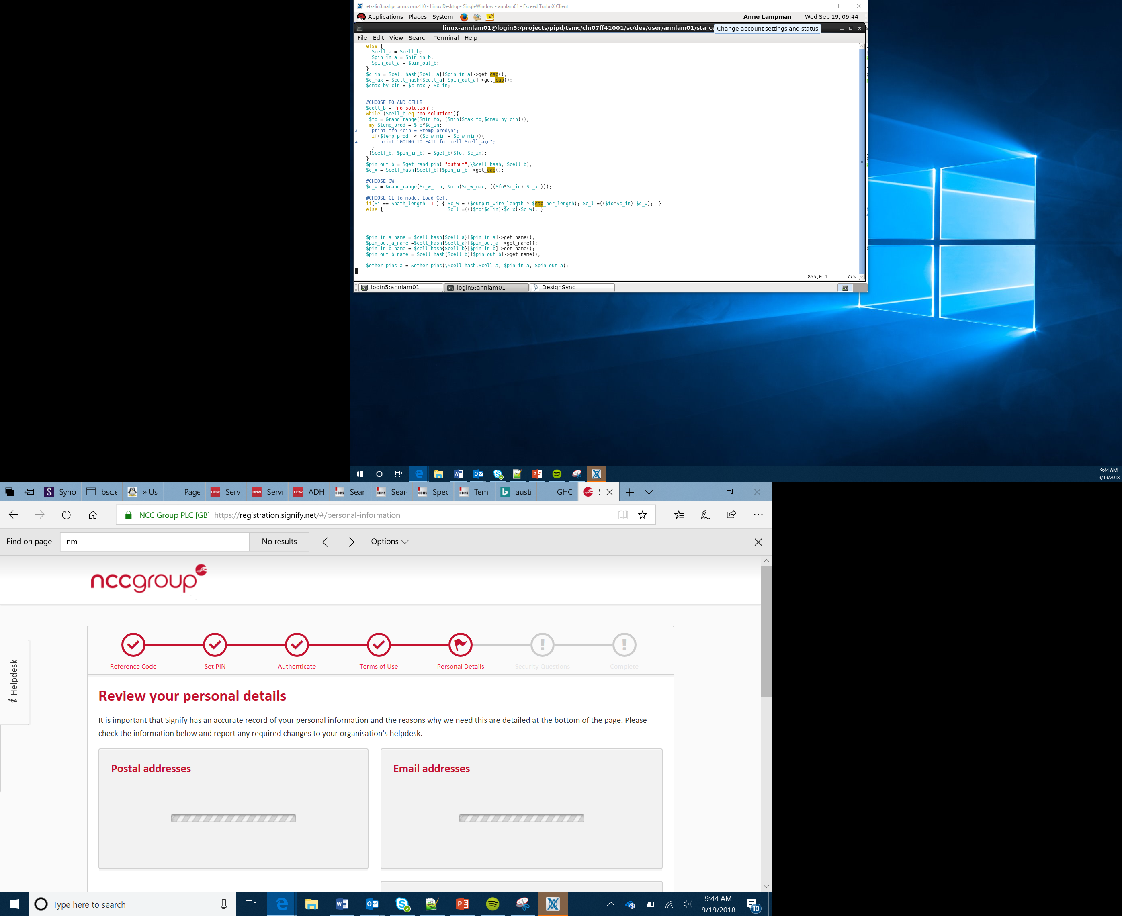

IoT project
Lesson 9

Slide 2
What you will produce:
A design for an Arduino-based product
Help to achieve one of the Global Goals for sustainable development
An Arduino based product controllable by the IoT
A logo and branding for your product
An ‘elevator pitch’ for your product (< 2 mins)

Slide 3
The four team roles
Project manager:
Tasks being completed on time
Checking everything is complete
Storing the product and designs safely
Engineer:
Designing the product
Making the product
Testing the product
Developer:
Designing the IPO process
Programming the Arduino
Testing the program
Marketing and communications:
Ensuring the team communicate
Creating the logo and branding the product
Writing the elevator pitch

Slide 4
Working in parallel
Project Manager
Engineer
Marketing and communications
Developer
Lesson 1
Lesson 2
Checking everything is going to plan and safely storing the work every lesson and helping everyone
Designing the product
Making the product
Testing the product
Developing the logo
Branding the product
Writing the elevator pitch
IPO planning
Programming the Arduino
Testing the program

Slide 5
Success criteria
Develop a product that uses the Arduino MKR and additional peripherals
Must help to achieve one of the Global Goals for sustainable development
You must design the product and an IPO table
Make a prototype of your product and test it
Brand your product and create a logo
Create an ‘elevator pitch’ (< 2 mins) to present your project

Slide 6
Your team will be judged on:
Idea
The product
Teamwork
Elevator pitch
How well you met the success criteria
Marketing

Slide 7
Choosing your product
Remember – time is limited. You need to quickly agree upon your product
Remember that these are just prototypes, not fully functional solutions although some element of functionality must be demonstrable
Think about the initial ideas which you came up with for devices in lesson 1 – these could give you some inspiration
Think about the different peripherals that you have used throughout the course. Could any of these be used in your final solution?

Slide 8
Global Goals
Your product should help to achieve one of the Global Goals
Visit https://www.globalgoals.org to review the global goals and select one as a team which your product will help to address

Slide 9
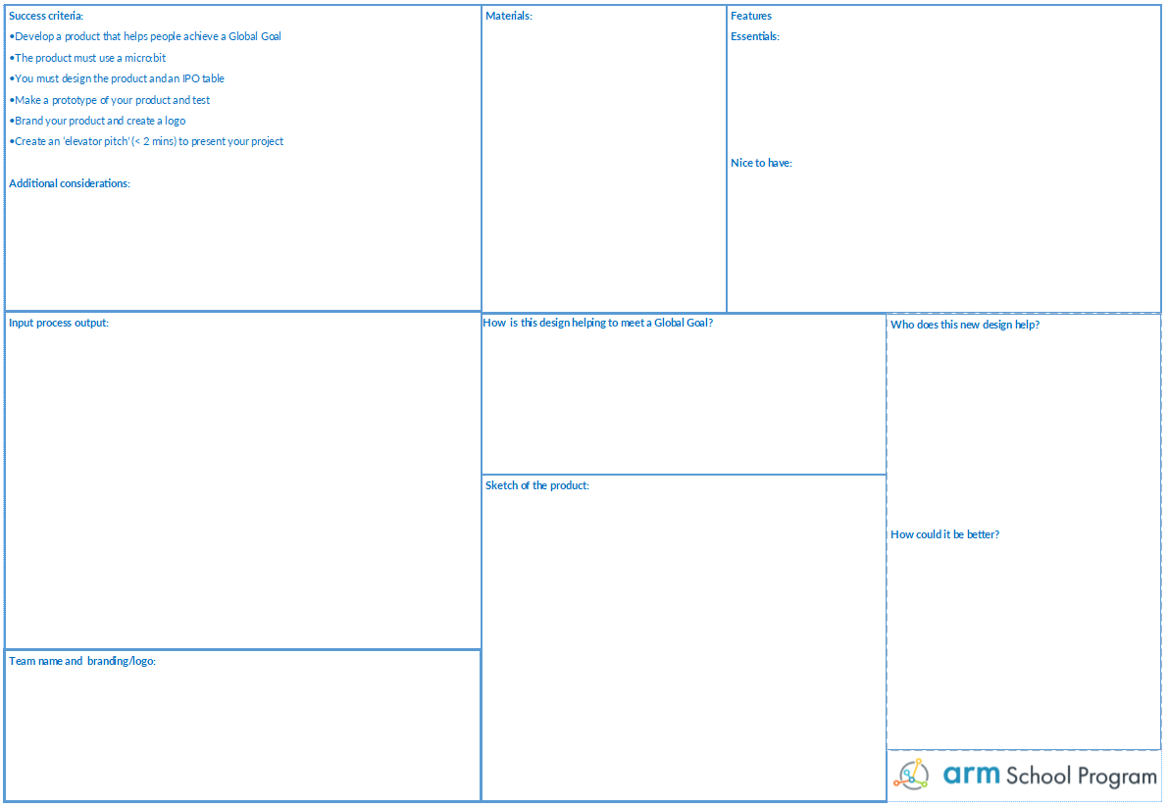
Get designing!
Use the design sheet to capture all your ideas
Think about:
Materials
Features – what is realistic?
IPO
Team name
Logo
How could it be improved?
Engineer
Project Manager
Developer
Marketing and communications

Slide 10
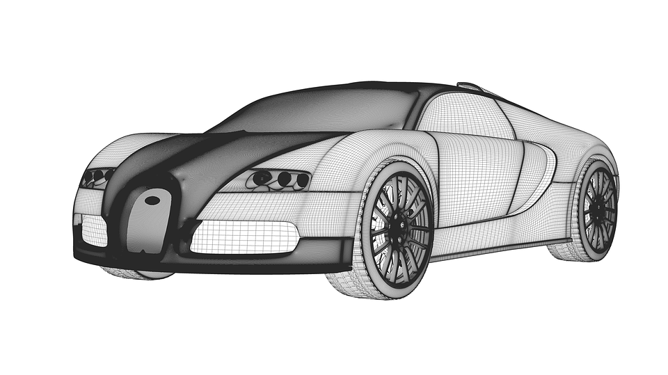
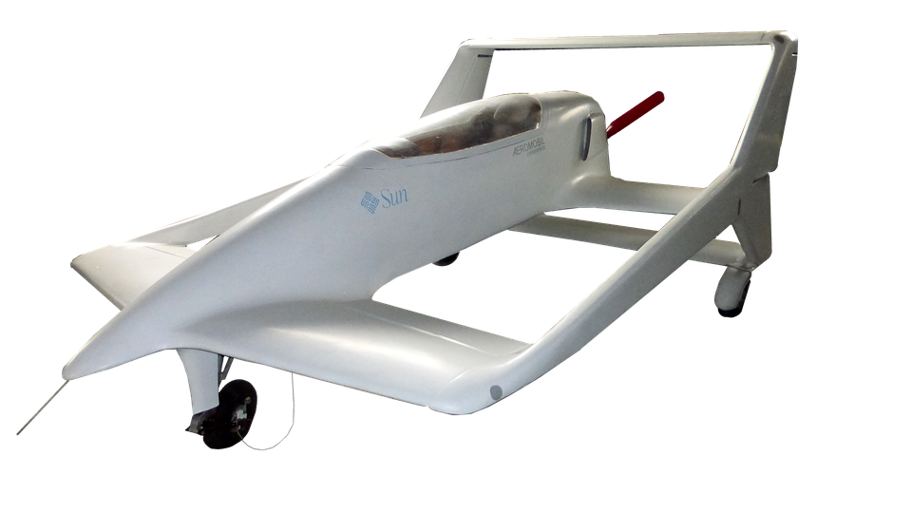
Being realistic
You have limited time
This is just a prototype
The design is just as important as the build
Keep it simple!

Slide 11
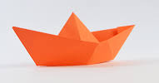
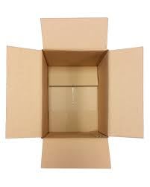
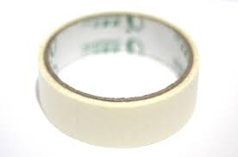
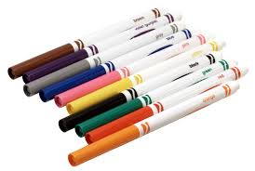
Gathering resources
The engineer will need to gather the materials needed to make the product:
Paper
Card
Tape
Glue
String
Pens

Slide 12

Fail early, fail often
First
Attempt
In
Learning

Slide 13

Branding
Don’t forget to brand the product
An effective brand should communicate the values (personality) of your product
Look at some examples of your favourite company logos to help you
Key features of effective logos include: small number of colours, relevant to your product, memorable
You can even use branding in the program!

Slide 14
Elevator pitches
Less than 2 minutes
Can use a presentation
Must describe which global goal the product helps achieve
Should effectively communicate how your product works to a non-technical audience
You should include a brief discussion of the input and output devices and code used to enable your product to work effectively

Slide 15
Evaluation
Complete the evaluation sheet
Reflect on your projects
What went well?
What could you do better?

